Slide 1
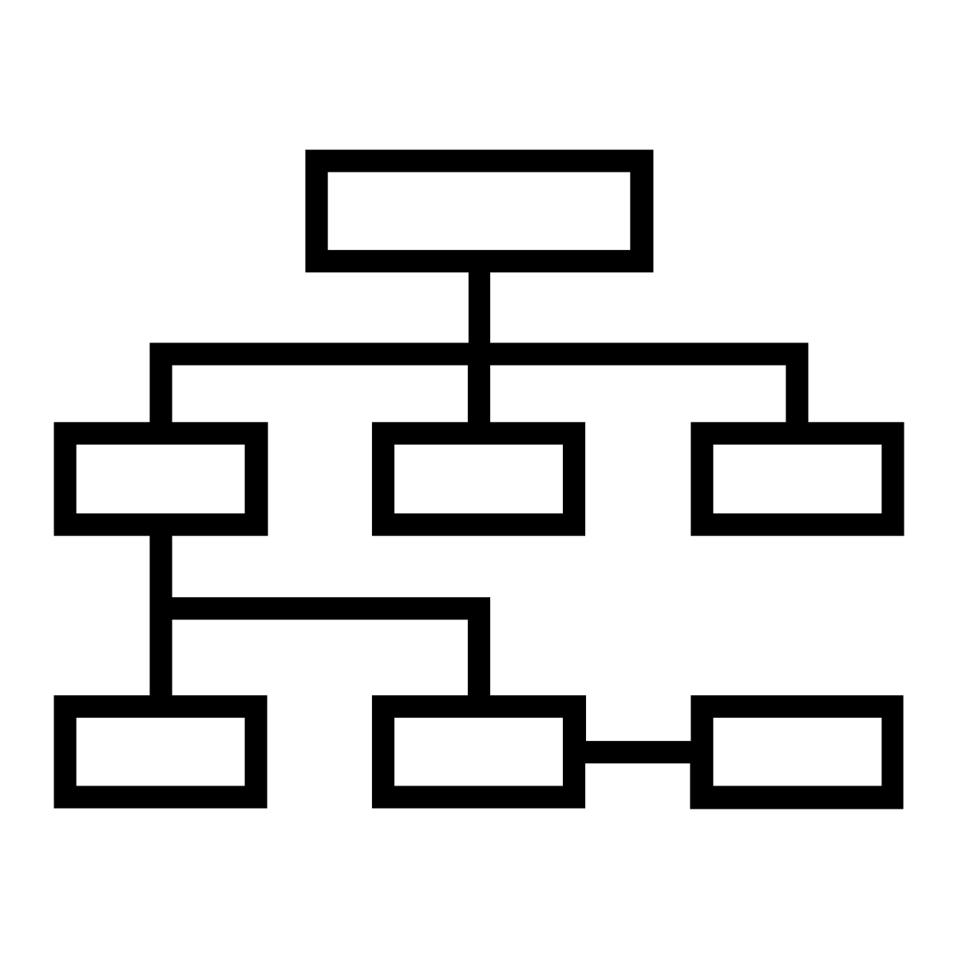
Navigation
2023-24

Slide 2
Navigation
The set of information that an application deals with is usually split into several screens, each devoted to portray a subset it and to allow specific kinds of user interactions
Users can move among these screens, according to a given set of routes, supported both by specific widgets in each screen as well as by other general purpose navigation items scaffolding the application, like the drawer menu or the top and bottom bars
In order to support this behaviour, the Jetpack Navigation library provides a set of basic components which can be assembled together to create the desired navigation experience
Supporting transitions and animations, deep linking, as well as several typical UI patterns

Slide 3
Required dependencies
The navigation library provides supports both for standard views and for Jetpack Compose ones
Leveraging on similar abstractions and conceptual models, but relying on different implementations
dependencies {
val navVersion = "2.7.6"
// Kotlin standard views
implementation("androidx.navigation:navigation-fragment-ktx:$navVersion")
implementation("androidx.navigation:navigation-ui-ktx:$navVersion")
// Jetpack Compose Integration
implementation("androidx.navigation:navigation-compose:$navVersion")
}

Slide 4
Basic abstractions
The NavController is the main abstraction offered by the library
It is a stateful component that keeps track of the back stack of screens as well as of the state of each screen
It offers a set of methods to navigate to a new screen, go back to a previous one, create a deep link, access the current route or those currently in the back stack
The NavHost is a composable that hosts the screen associated to the current route contained in the NavController
Whenever a navigation occurs, the content of the NavHost is automatically recomposed to reflect the new route
The navigation graph is a resource that describes the set of routes the applications support with their parameters and associated screens
A Domain Specific Language (DSL) is provided to build the graph that the NavHost manages

Slide 5
Defining routes
Each screen in the application is identified by a route
A unique path-like string, made of one or more segments separated by "/"
Route segments may consists of constants or variables ("taskDetail/{taskId}"), similarly to placeholders in URLs
Routes can also contain optional parameters, using the query string notations ("taskDetail?taskId={taskId}")
The NavHost composable offers a DSL to describe the navigation graph
Each vertex in the graph consists of a destination type enclosing the corresponding route and the associated composable
Three types of destinations are possible:
composable (displayed inside the NavHost), dialog (overlayed to the NavHost), activity (managed by a different activity)

Slide 6
Defining routes
@Composable
fun SomeApp() {
val navController = rememberNavController()
NavHost(navController = navController, startDestination = "home") {
composable("home") {
HomeScreen( /* params */ )
}
dialog("addProject") {
AddProjectDialog( /* params */ )
}
composable("editProject/{projectId}",
arguments = listOf( navArgument("projectId"){type=NavType.IntType}
) { entry ->
EditProjectScreen( projectId = entry.arguments?.getInt("projectId"), /…/)
}
}
}

Slide 7
Navigating between screens
NavController offers a set of methods to move to a new route or go back to a previous one
It is often convenient not to access it directly, but to encapsulate the expected navigation actions into functions, to reduce mistakes
These functions can be propagated as properties to children composable, guaranteeing the correct addressing of routes and their parameters
class Actions(val navCont: NavHostController){
val addProject: ()->Unit = {
navCont.navigate("addProject")
}
val editProject:(Int)->Unit = { id ->
navCont.navigate("editProject/${id}")
}
val navigateBack: ()->Unit = {
navCont.popBackStack()
}
}
@Composable
fun SomeApp() {
val navController = rememberNavController()
val actions = remember(navController) {
Actions(navController)
} /* … */
}

Slide 8
Navigating between screens
The NavController manages visited routes through a Back Stack
Each time a navigation(...) action takes place, a new entry is pushed onto the stack, causing the NavHost to recompose
The popBackStack(route, inclusive) method is used to navigate back to a specific route
The physical back key (or its corresponding gesture) is automatically mapped to the popBackStack() method
add Project
navController
.navigate("addProject")
Home
home

Slide 9
Managing navigation state
Each entry in the stack may contain a SavedStateHandle instance
It consists of a key-value map where custom data may be written and retrieved
These values will persist after the process is killed by the system and remain available via the same object until the entry is specifically removed from the stack
This feature may be used to return a result to a previous destination
When a component (like an input form or a dialog asking for feedback) collects information to be returned to the previous screen, such piece of information can be stored in the navigation state
Button(onClick = {
navController.previousBackStackEntry?.saveStateHandle?.set("someKey",someValue)
navController.popBackStack()
}) { Text("Ok") }

Slide 10
Triggering the navigation
The NavHost/NavController pair offers a convenient solution for displaying the current screen and handling navigation events, however these events need to originate somewhere in the user interface
Compose offers a convenient set of composables aimed at presenting potential destinations and trigger navigation events
Depending on the requirements of the application, some screen should be reachable from any other page or just be accessible under some constraint
The former can be hosted on the top or the bottom of the screen, via a TopAppBar or a BottomAppBar
The latter may be listed in a NavigationDrawer or in a set of Tabs

Slide 11
The Scaffold composable
Component that implements the basic material design visual layout structure, managing several sub-components
Top App Bar (a.k.a. Toolbar)
Floating Action Button
Bottom Navigation
Each of these sub-components is expressed via a composable lambda
Scaffold(
topBar = { MyTopBar() }, bottomBar = { MyBottomBar() },
snackBarHost = { MySnackBarHost() } floatingActionButton = { MyFAB() }
) {
paddingValues: PaddinValues ->
//Here goes the main page content
}

Slide 12
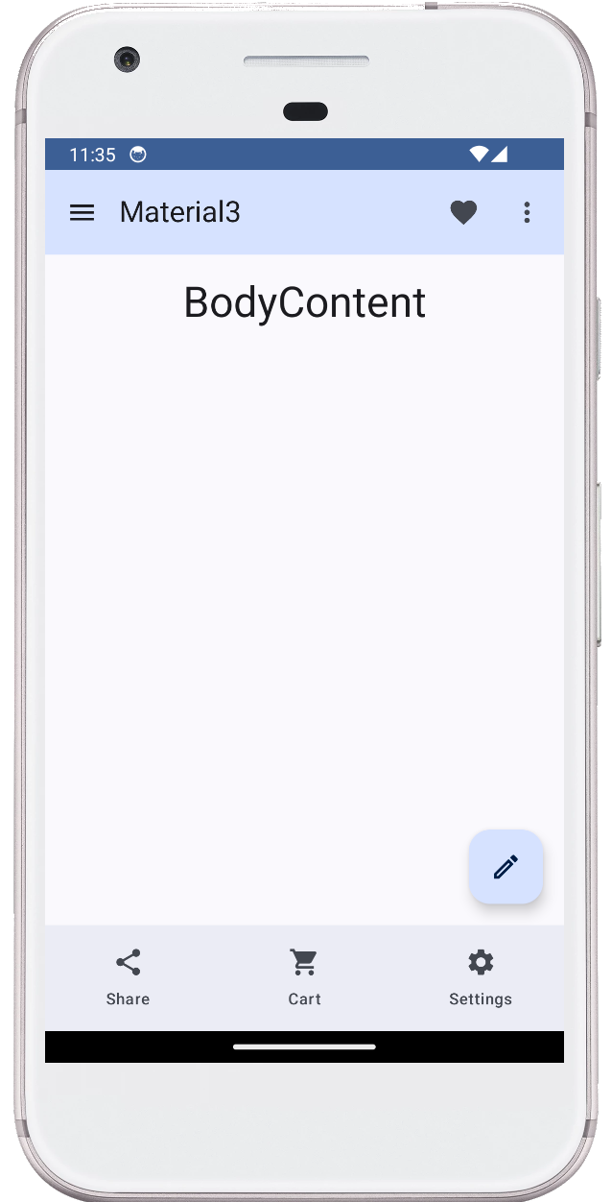
Scaffold
@Composable
fun Material3Demo() {
Scaffold(
topBar = { MyTopBar() },
floatingActionButtonPosition = FabPosition.End,
floatingActionButton = {
FloatingActionButton(onClick = { /*TODO*/ }) {
Icon(Icons.Outlined.Create, "Create")
}
},
bottomBar = { MyBottomBar() },
content = { paddingValues ->
MyContent(paddingValues = paddingValues)
},
)
}
topBar
content
FAB
bottomBar

Slide 13
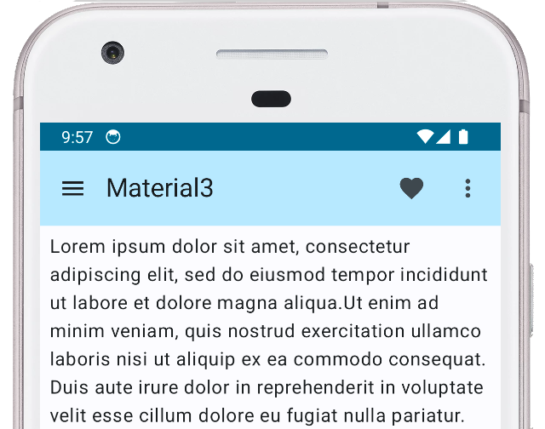
TopAppBar
TopAppBar displays navigation, actions, and text at the top of a screen
@Composable @OptIn(ExperimentalMaterial3Api::class)
fun SimpleTopAppBar() {
Scaffold(topBar = {
TopAppBar(
title = {Text("Material 3")},
navigationIcon = {
IconButton(onClick = {/*doSomething()*/}) {
Icon(imageVector = Icons.Filled.Favorite,
contentDescription = "Favorite") }
},
colors = TopAppBarDefaults.smallTopAppBarColors(
containerColor = Color.cyan)
)},
}) { /* content here */

Slide 14
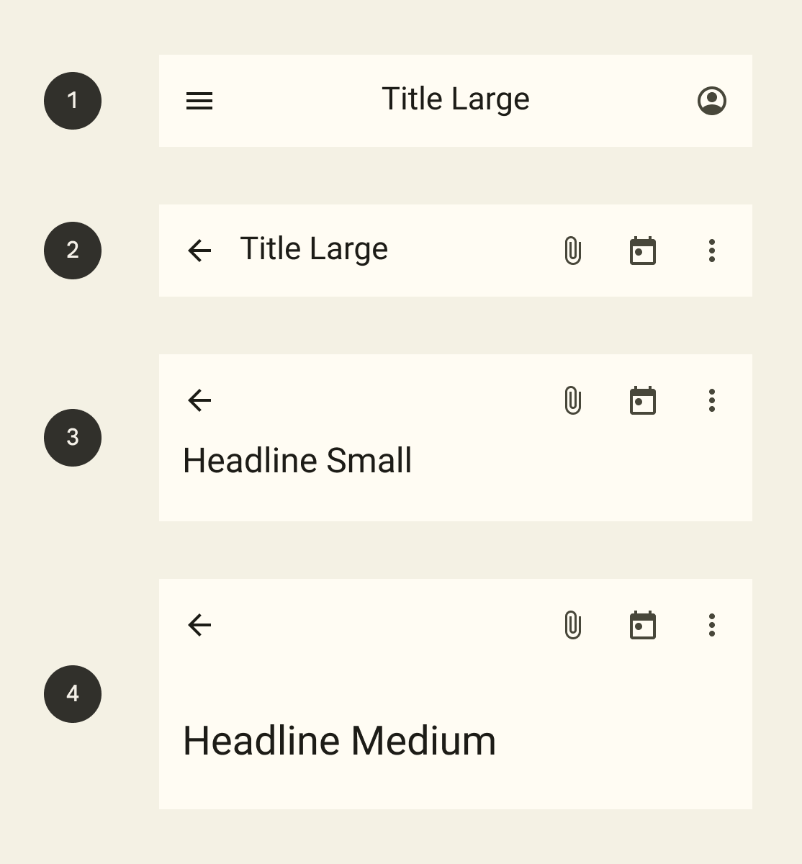
TopAppBar
There are several versions of the TopAppBar that differ in the disposition of the elements:
The CenterAlignedTopAppBar has a header title that is horizontally aligned to the center. (1)
The SmallTopAppBar has a header title that is horizontally aligned to the right and on the same line as icons and actions. (2)
The LargeTopAppBar and MediumTopAppBar display the title in a second row below the navigation and actions when in its default expanded state. The title has more or less line spacing, respectively. (3 , 4)

Slide 15
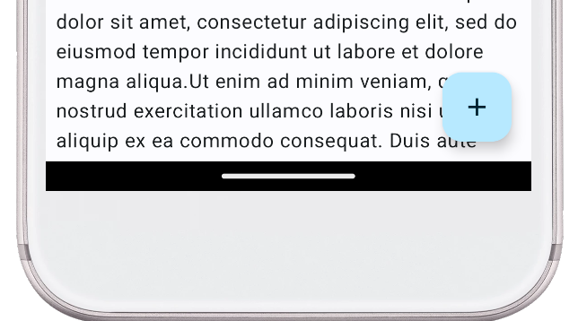
FloatingActionButton (FAB)
A FloatingActionButton allow users to execute a fast action or go to the next screen
@Composable
fun ShowFABSample() {
Scaffold(
topBar = { /**/ },
content = { /**/ },
floatingActionButton = {
FloatingActionButton(onClick = { /**/ }) {
Icon(Icons.Filled.Add, "Add")
}
}
)
}

Slide 16
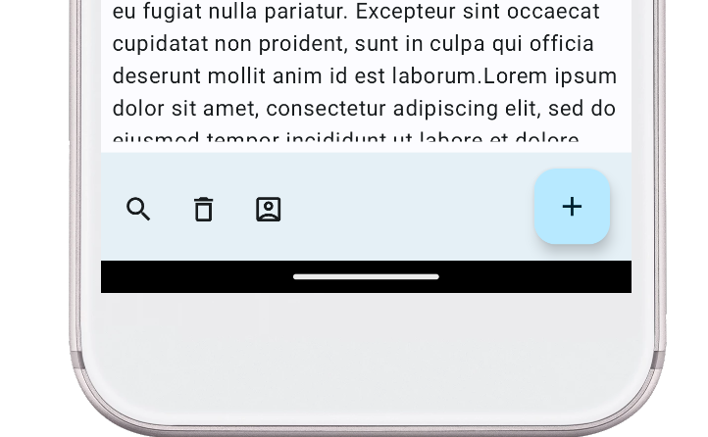
BottomAppBar
Bottom Navigation displays navigation and key actions at the bottom of mobile and tablet screens that are easy to reach on a mobile device
@Composable
fun BottomAppBarWithFAB() {
BottomAppBar (
actions = {
IconButton(onClick = {}) {Icon(Icons.Outlined.Search, "Search")}
IconButton(onClick = {}) {Icon(Icons.Outlined.Delete, "Delete")}
IconButton(onClick = {}) {Icon(Icons.Outlined.AccountBox, "Account")}
},
floatingActionButton = {
FloatingActionButton(onClick = { /*TODO*/ }) {
Icon(Icons.Filled.Add, "Add")
}
},
)
}

Slide 17
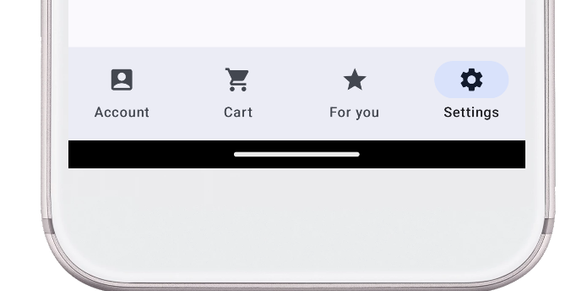
NavigationBar
Navigation bars let people switch between UI views on smaller devices
@Composable
fun NavigationBarSample() {
var selectedItem by remember { mutableIntStateOf(0) }
val items = listOf("Account", "Cart", "For you", "Settings")
val icons = listOf(Icons.Filled.AccountBox, Icons.Filled.ShoppingCart,
Icons.Filled.Star, Icons.Filled.Settings)
NavigationBar () {
items.forEachIndexed { index, item ->
NavigationBarItem(
selected = index == selectedItem,
onClick = { selectedItem = index },
icon = { Icon(icons[index], item) },
label = { Text(item) } )
}
}
}

Slide 18
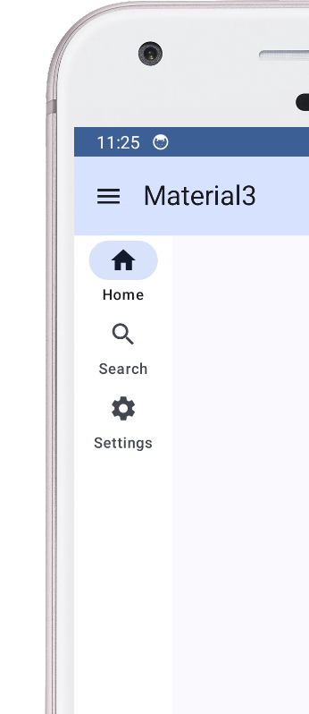
NavigationRails
Navigation Rails let people switch between UI views on mid-sized devices
@Composable
fun NavigationRailSample(visible: Boolean) {
var selectedItem by remember { mutableIntStateOf(0) }
val items = listOf("Home", "Search", "Settings")
val icons = listOf(Icons.Filled.Home, Icons.Filled.Search,
Icons.Filled.Settings)
Row() {
AnimatedVisibility(visible = visible) {
NavigationRail(containerColor = Color.White) {
items.forEachIndexed { index, item ->
NavigationRailItem(
icon = { Icon(icons[index], item) },
label = { Text(item) },
selected = selectedItem == index,
onClick = { selectedItem = index } ) }
} } } }

Slide 19
Navigation Drawer
The navigation drawer component is a slide-in menu that lets users navigate to various sections of your app
Users can activate it by swiping from the side or tapping a menu icon
Drawers help organizing navigation destinations in different categories
As well as facilitating users to discover features provided by complex apps
Or getting quick links to special sections of the app, like the user profile or the setting screen
Material Design supports two types of drawers
Standard drawers, that share space within a screen with other content
Modal drawers, that appear over the top of other content

Slide 20
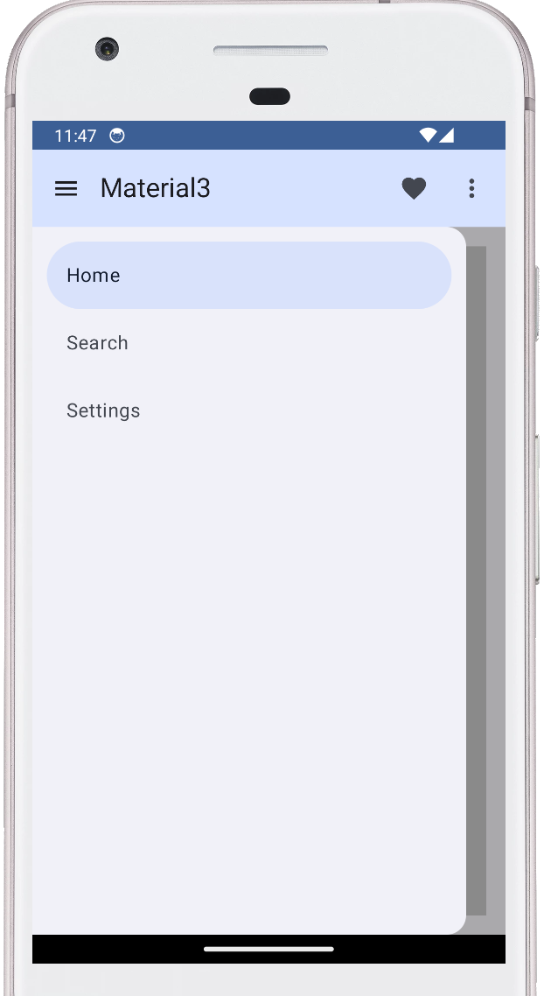
NavigationDrawer
@Composable
fun NavDrawerSample(drawerState: DrawerState, scope: CoroutineScope) {
var selectedItem by remember { mutableIntStateOf(0) }
val items = listOf("Home", "Search", "Settings")
ModalNavigationDrawer(
drawerState = drawerState,
drawerContent = {
ModalDrawerSheet {
Spacer(modifier = Modifier.height(12.dp))
items.forEachIndexed { index, item ->
NavigationDrawerItem(
label = { Text(item) },
selected = index==selectedItem ,
onClick = { selectedItem = index
scope.launch { drawerState.close() } },
modifier = Modifier.padding(
NavigationDrawerItemDefaults.ItemPadding))
} } } ) { /* page content goes here */ } }

Slide 21
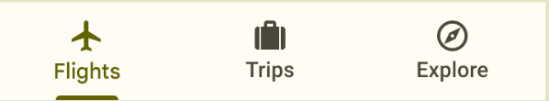

Tabs
Tabs are used to group content into useful categories
They are of two types (primary and secondary) and can scroll horizontally, so the user interface can have as many tabs as needed
Primary tabs are typically placed at the top of the content pane under a top app bar
They allow to quickly switch between related content destinations
Tabs contained in a PrimaryTabRow are evenly spaced and fill the entire available space
Secondary tabs tabs are used within a content area to further separate related content and establish hierarchy

Slide 22
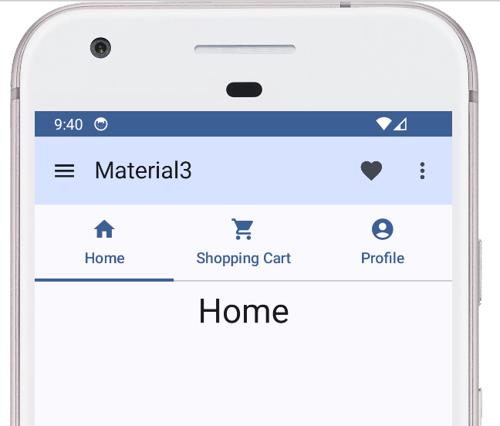
Tabs
@Composable
@OptIn(ExperimentalMaterial3Api::class)
fun TabDemo(modifier: Modifier) {
var state by remember { mutableStateOf(0) }
val icons = listOf(Icons.Filled.Home, Icons.Filled.ShoppingCart, Icons.Filled.AccountCircle)
val titles = listOf("Home", "Shopping Cart", "Profile")
Column(modifier = modifier) {
TabRow(selectedTabIndex = state) {
titles.forEachIndexed { index, title ->
Tab(selected = state == index,
onClick = { state = index },
text = { Text(text = title) },
icon = { Icon(icons[index],title) })
}
}
Text(modifier = Modifier.align(Alignment.CenterHorizontally.padding(8.dp),
text = titles[state],
style = MaterialTheme.typography.headlineLarge)
}
}

Slide 23

Learning more
Android/Kotlin/Jetpack Compose: Navigation
https://medium.com/@2018.itsuki/android-kotlin-jetpack-compose-navigation-2e74d782328c
Step by step guide for implementing navigation in Jetpack Compose
Compose Navigation — A great choice for large Android apps
https://itnext.io/compose-navigation-a-great-choice-for-large-android-apps-94c02984acd5
An in-depth discussion of how to handle navigation in larger application
Best Practices for Compose Navigation in Multi-Module Project
https://proandroiddev.com/best-practices-for-compose-navigation-in-multi-module-project-eec79ddcef4d
Another useful article discussing navigation best practices in large projects
Navigation drawer in JetPack Compose with Material Design 3 components
https://medium.com/@auroraanirudh/navigation-drawer-in-jetpack-compose-with-material-design-3-components-2c7775fa2bce
Further details for implementing a consistent navigation drawer

